Slide 1
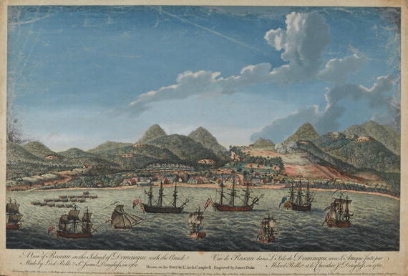
David Nicholls Memorial Trust Lecture 2011
Dr David Lambert
University of Warwick
‘In but not of the West’:
Caribbean histories and geographies

Slide 2
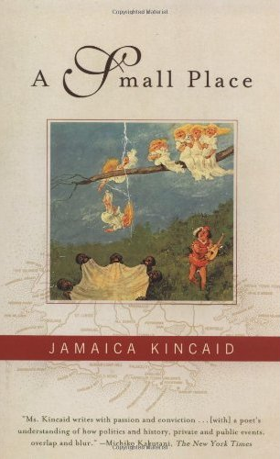
If you go to Antigua as a tourist, this is what you will see. If you come by aeroplane, you will land at the V. C. Bird International Airport. Vere Cornwall (V. C.) Bird is the Prime Minister of Antigua. You may be the sort of tourist who would wonder why a Prime Minister would want an airport named after him – why not a school, why not a hospital, why not some great public monument (Kincaid, 1988)

Slide 3
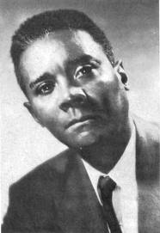
Although the Caribbean lies at the heart of the western hemisphere and was historically pivotal in the rise of Europe to world predominance, it has nevertheless been spatially and temporally eviscerated from the imaginary geographies of ‘Western modernity’. The imagined community of the West has no space for the islands that were its origin, the horizon of its self-perception, the source of its wealth…As C. L. R. James once put it, the Caribbean is ‘in but not of the West’... (Sheller, 2003)

Slide 4
[I]t is inaccurate to refer to the Caribbean as a ‘cultural area’, if by ‘culture’ is meant a common body of historical tradition. The very diverse origins of Caribbean populations; the complicated history of European cultural impositions; and the absence in most such societies of any firm continuity of the culture of the colonial power have resulted in a very heterogeneous cultural picture. And yet the societies of the Caribbean...exhibit similarities that cannot possibly be attributed to mere coincidence. It probably would be accurate (though stylistically unwieldy) to refer to the Caribbean as a ‘societal area’, since its components societies probably share more social-structural features than they do cultural features (Mintz, 1966)

Slide 5
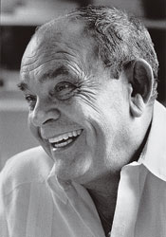
I think that the arrival and proliferation of the plantations is the most important historical phenomenon to have come about in the Caribbean, to the extent that if it had not occurred the islands of the region might today perhaps be miniature replicas – at least in demographic and ethnological terms – of the European nations that colonized them (Benítez-Rojo, 1992)

Slide 6
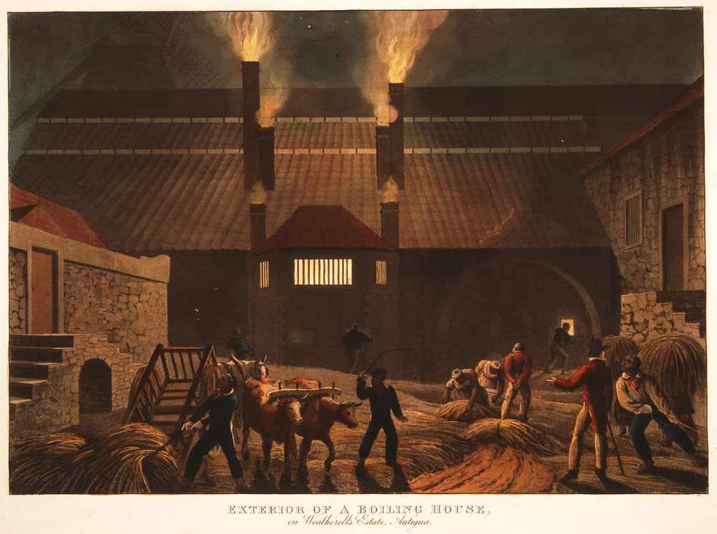

Slide 7
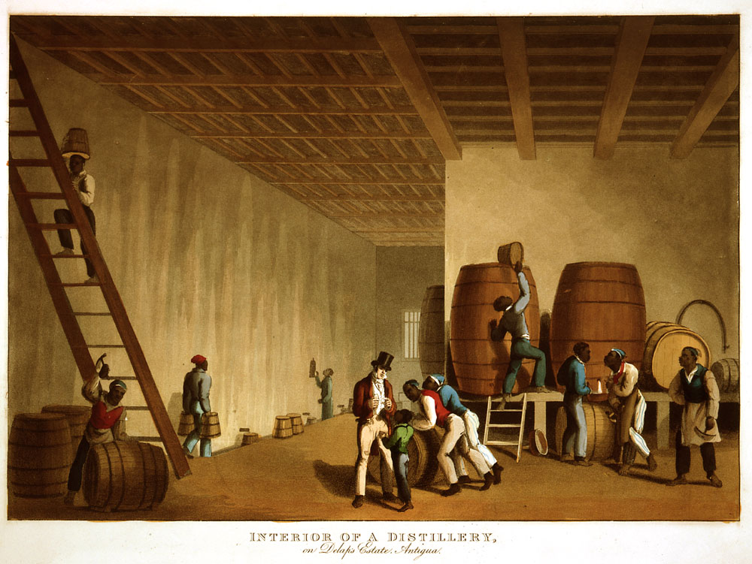

Slide 8
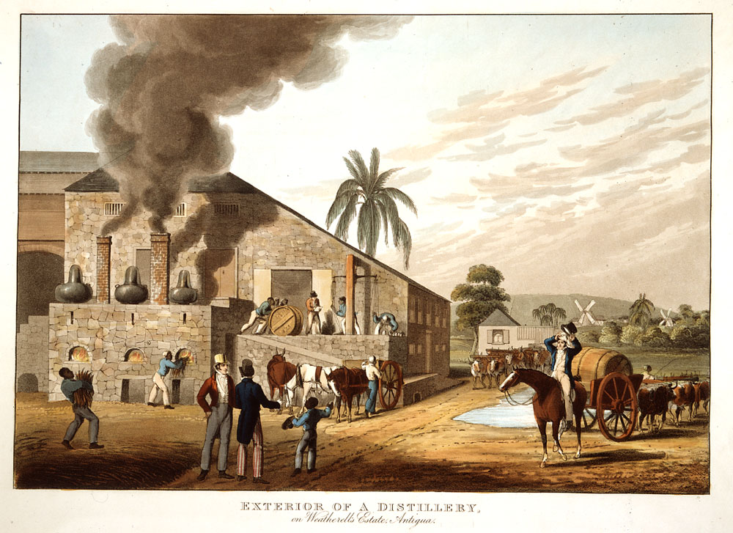

Slide 9
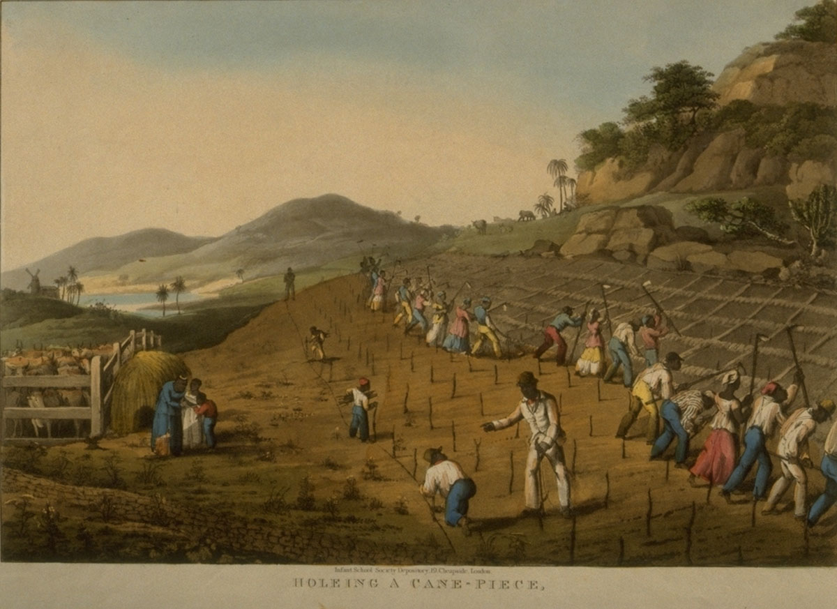

Slide 10
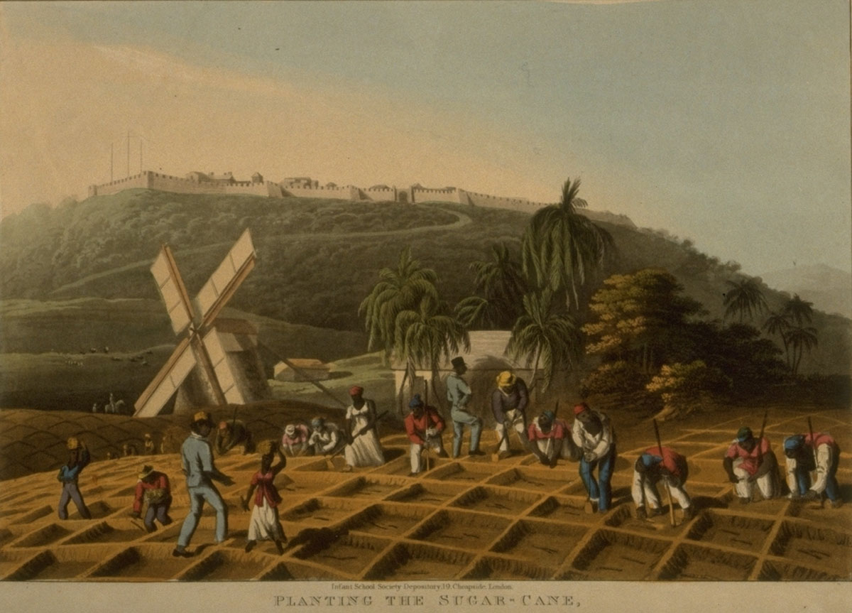

Slide 11
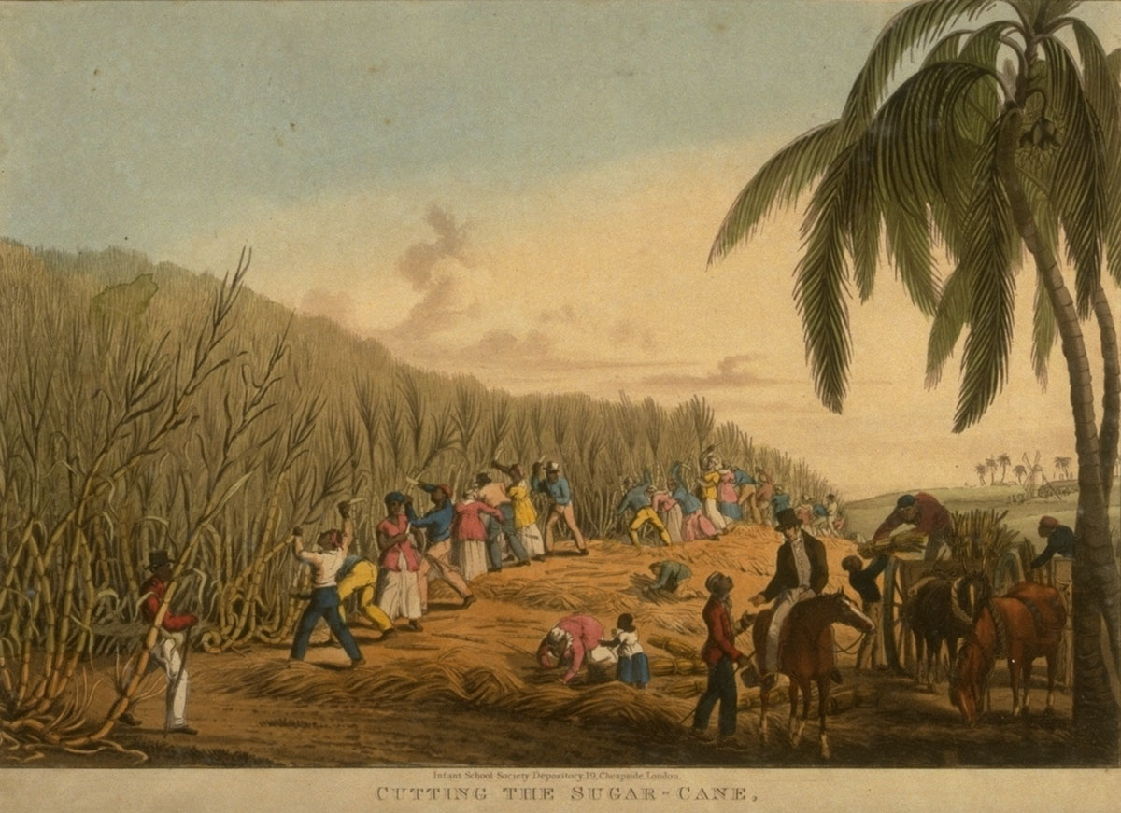

Slide 12
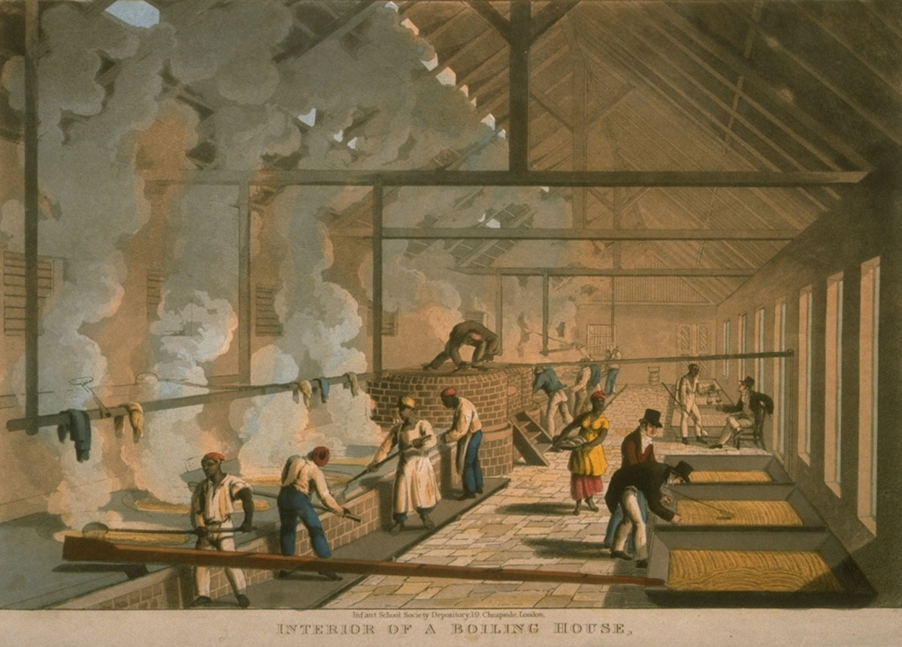

Slide 13
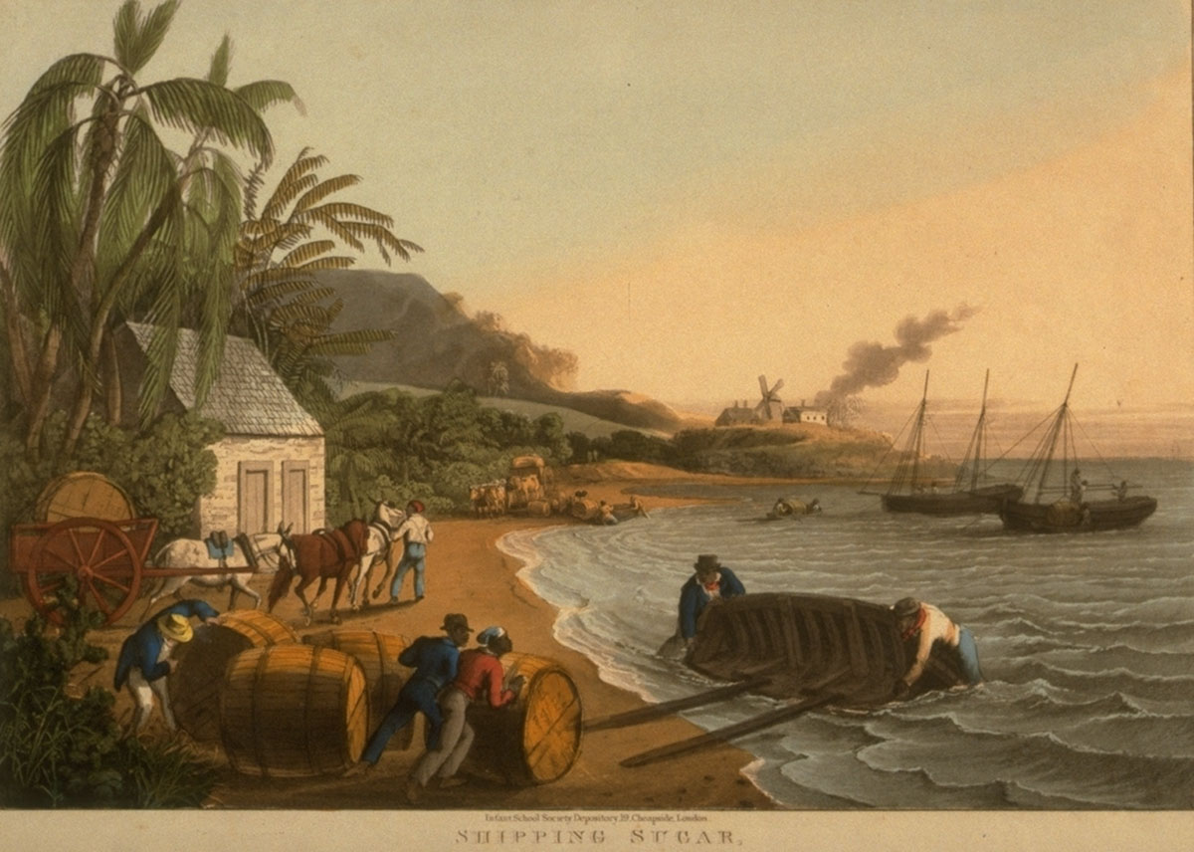

Slide 14
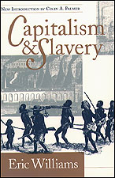
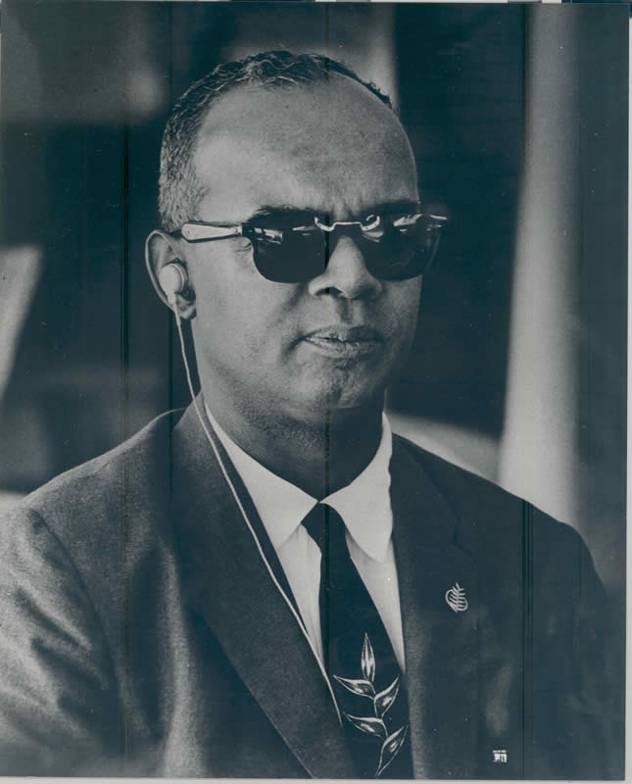

Slide 15
Britain was accumulating great wealth from the triangular trade. The increase in consumption of goods called forth by that trade inevitably drew in its train the development of the productive power of the country. This industrial expansion required finance. What man in the first three-quarters of the eighteenth century was better able to afford the ready capital than a West Indian sugar planter or a Liverpool slave trader?...[T]he investment of profits from the triangular trade in British industry…supplied part of the huge outlay for the construction of the vast plants to meet the needs of the new productive process and the new markets (Williams, 1944)

Slide 16
Notes:
Slaves Receiving News of Emancipation, British West Indies, ca. 1834
http://hitchcock.itc.virginia.edu/Slavery/details.php?filename=cass2

Slide 17
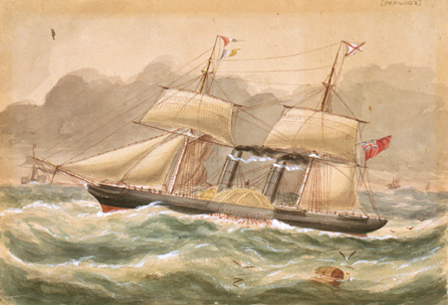

Slide 18
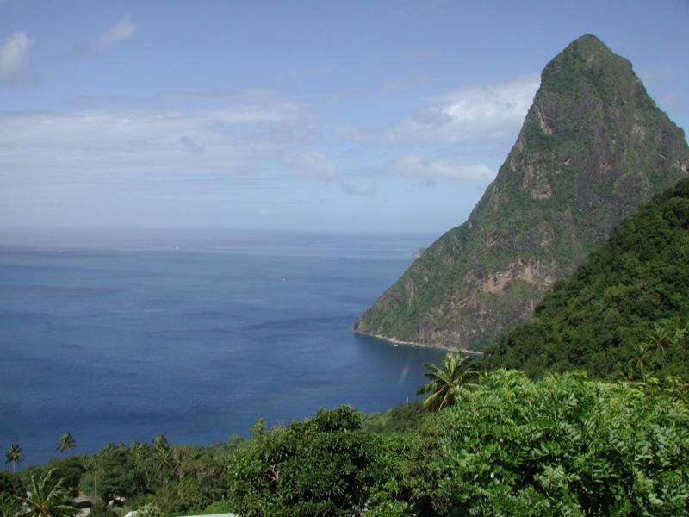

Slide 19
Here, for the first time, was the tropical beach! How often, from childhood, I had tried to picture it from Kingsley’s vivid descriptions of the histories of the early explorers. There were the cocoa-nut palms, with clusters of green cocoa-nuts growing all along the sea-line out of the soft white sand, with beautiful rainbow colours in the water as it moved lazily backwards and forwards, glittering in the brilliant sunlight (Hastings Jay, 1900)

Slide 20
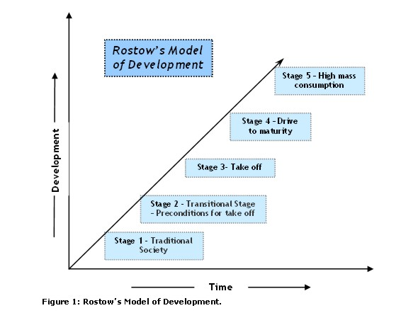

Slide 21
You have brought your own books with you, and among them is one of those new books about economic history, one of those books explaining how the West (meaning Europe and North America after its conquest and settlement by Europeans) got rich: the West got rich not from the free (free - in this case meaning got-for-nothing) and then undervalued labour, for generations, of the people like me you see walking around you in Antigua but from the ingenuity of small shopkeepers in Sheffield and Yorkshire and Lancashire, or wherever; and what a great part the invention of the wristwatch played in it, for there was nothing noble-minded men could not do when they discovered they could slap time on their wrists just like that (isn’t that the last straw; for not only did we have to suffer the unspeakableness of slavery, but the satisfaction to be had from “We made you bastards rich” is taken away, too), and so you needn’t let that slightly funny feeling you have from time to time about exploitation, oppression, domination develop into a full-fledged unease, discomfort; you could ruin your holiday (Kincaid, 1988)

Slide 25
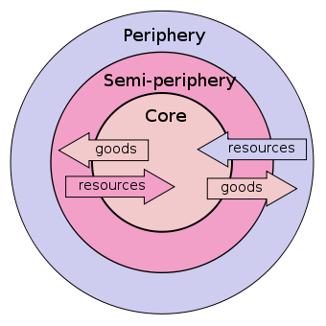

Slide 28
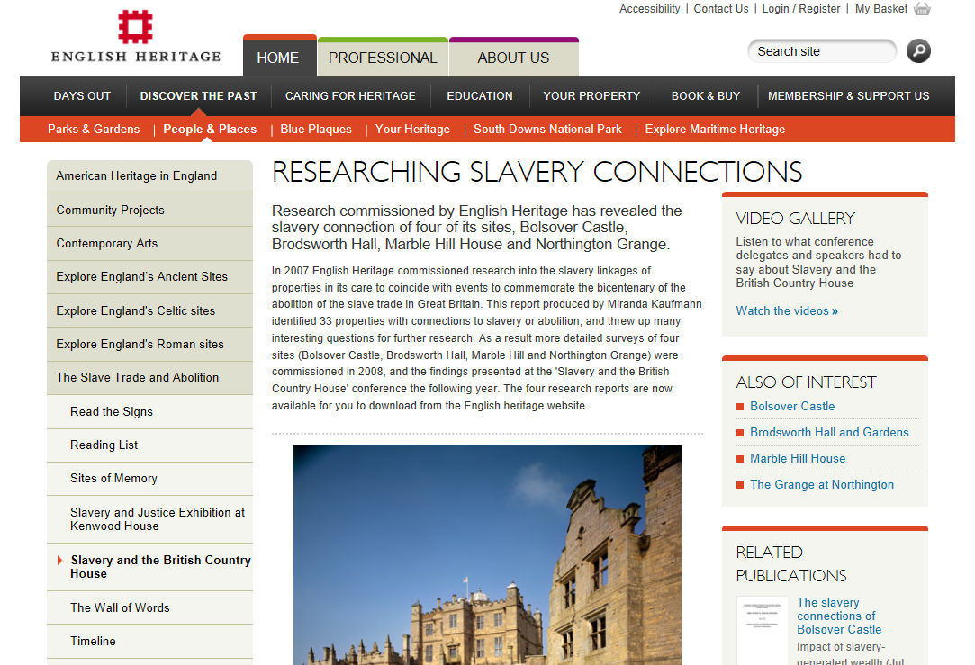
Notes:
Sugar Plantation Mill Yard, Antigua, West Indies, 1823

Slide 29
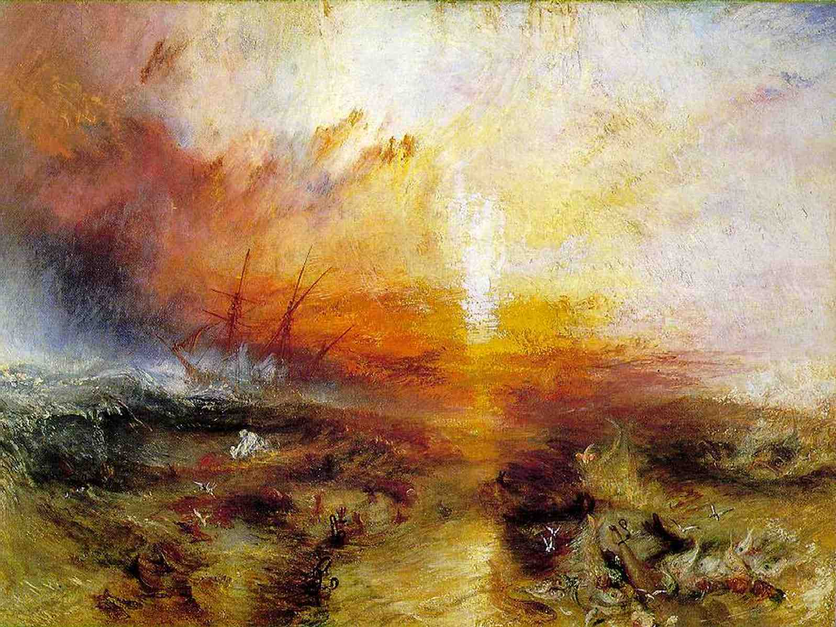
[T]he sea-crossing technologies – canoe, caravel, and container ship – serve as symbols of the main periods of Caribbean history. The last – the container ship – defines a short period, the last fifty years. The caravel stands for a period ten times as long, the 500 years from 1492. The canoe accounts for another multiple of ten, the previous 5,000 years or more. Each of these vessels carried with them whole cultures, representing an increasingly global cargo (Higman, 2010)

Slide 30
Major phases in Caribbean history
Sixteenth to seventeenth centuries: period of ‘discovery’ and dispossession of indigenous population.
Eighteenth to mid-nineteenth centuries: growth of plantation slavery and intra-imperial conflict.
Mid-nineteenth to mid-twentieth centuries: ‘free labour’ plantation commodity and increasing USA involvement.
Late twentieth century to today: decolonisation and explosion of tourism.
1492-1630 – Columbian cataclysm
1630-1770 – Plantation peoples
1770-1870 – Rebels and revolutionaries
1870-1945 – Democrats and dictators
1945 – decolonisation, migration, tourism

Slide 33
